Slide 1

Fundamentals of the analysis of neuronal oscillations
Eelke Spaak

Slide 2
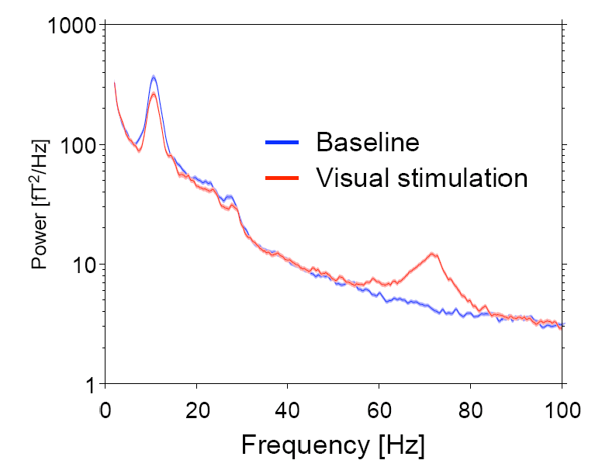
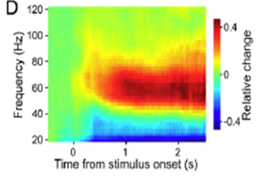
Outline
Spectral analysis
Time frequency analysis

Slide 3
Motivation
Neuronal synchronization changes over time
Spontaneous activity
Event and task related changes in experiments

Slide 4
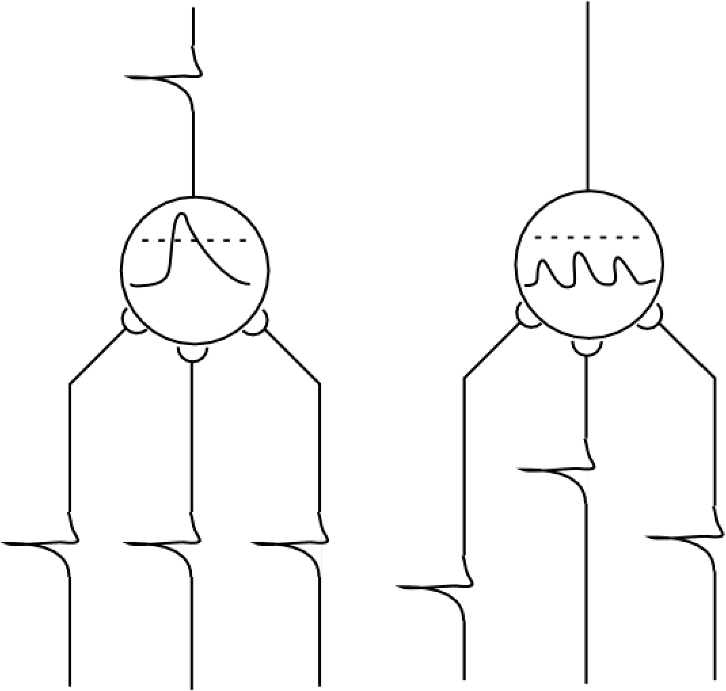
Local synchronization

Slide 5
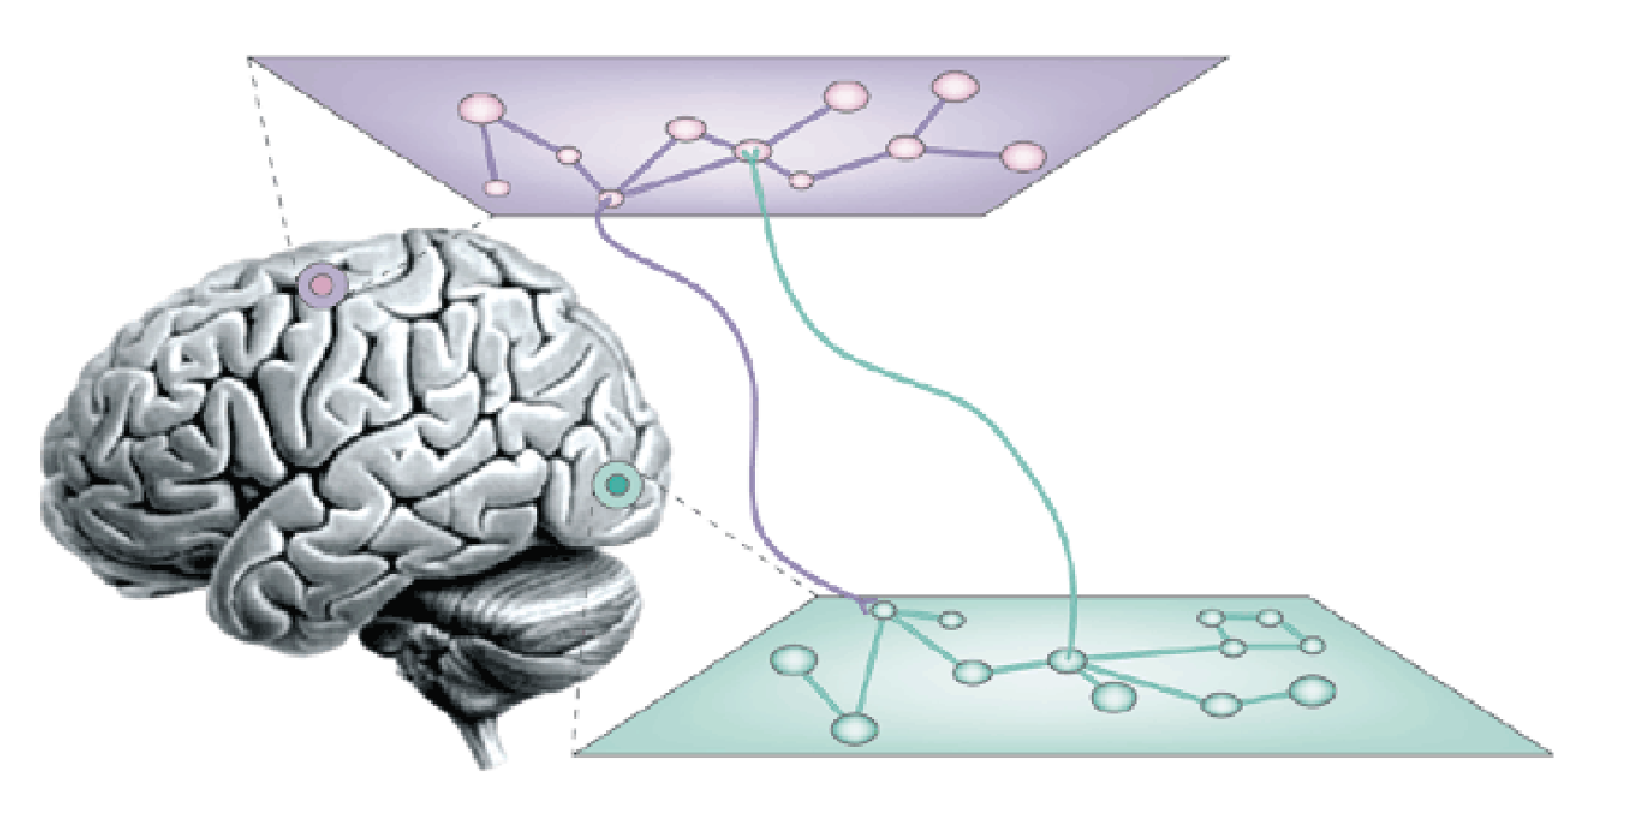
Long range synchronization
Not the focus of this talk

Slide 6
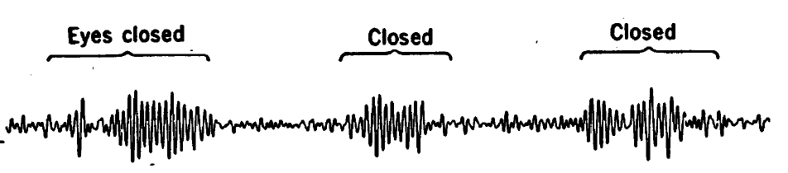
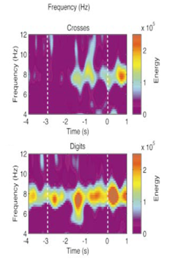
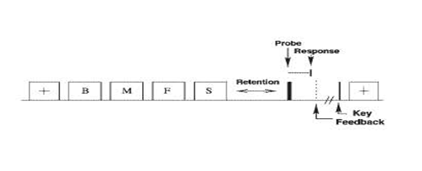
Brain signals contain oscillatory activity at multiple frequencies
Alpha ~10Hz
Cohen, 1972
Theta
~7Hz
Jensen et al, 1999

Slide 7
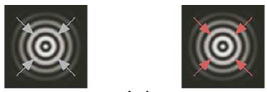
Brain signals contain oscillatory activity at multiple frequencies
Gamma
~40-90 Hz
Hoogenboom et al, 2006
Notes:
7

Slide 8
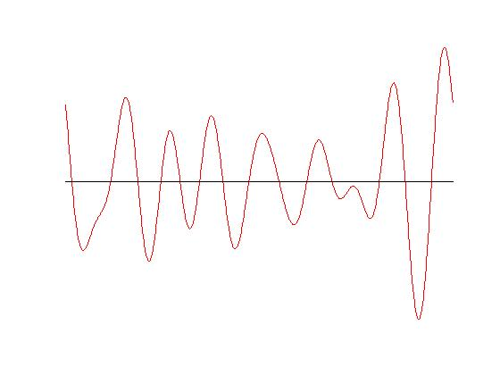
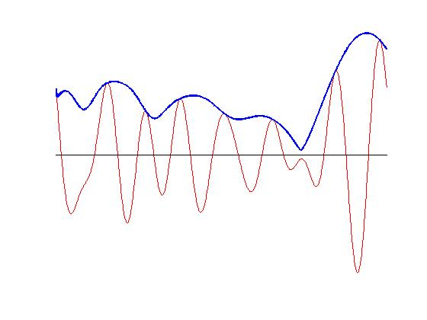
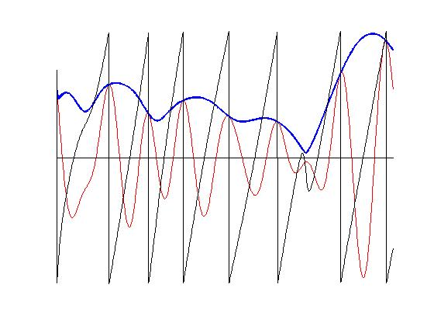
A background note on oscillations
amplitude
period
phase

Slide 9
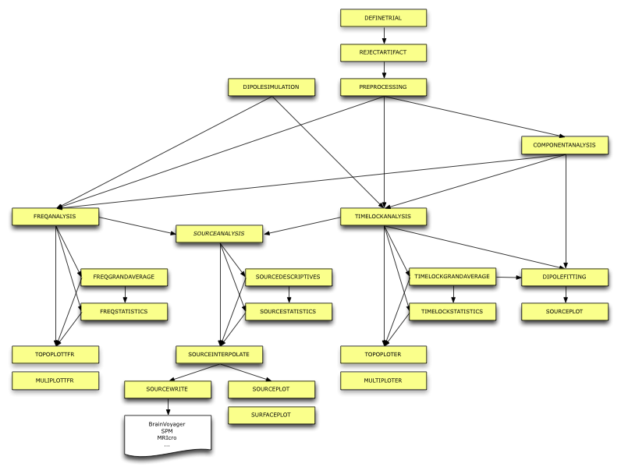
Fieldtrip function for analysis of oscillations

Slide 10
Spectral analysis
Deconstructing a time domain signal into its constituent oscillatory components
Using simple oscillatory functions: cosines and sines

Slide 11
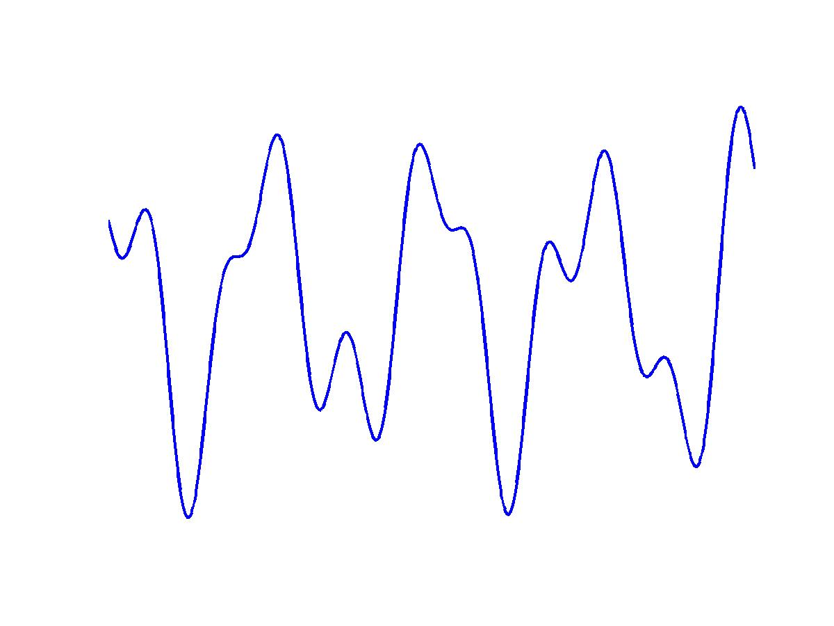
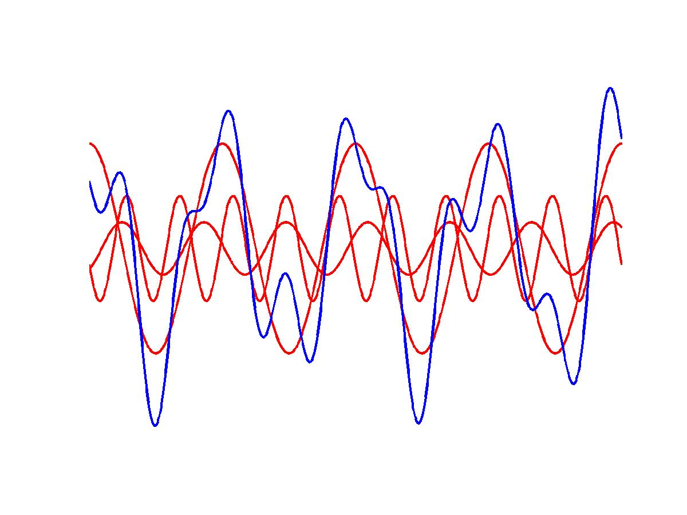
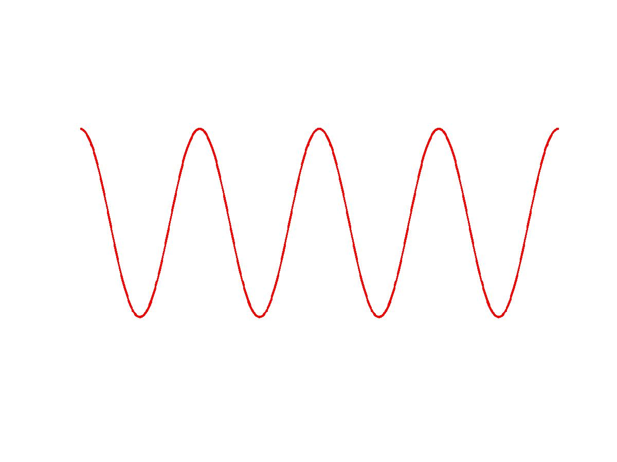
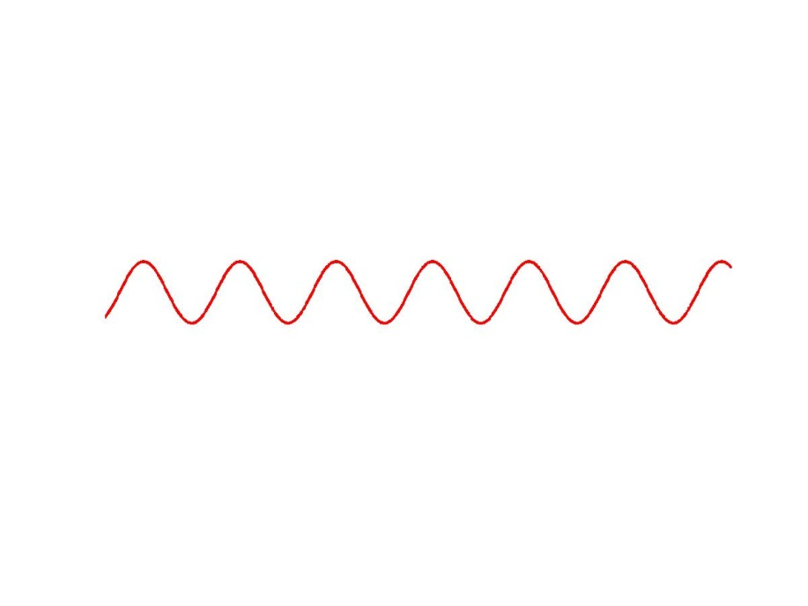
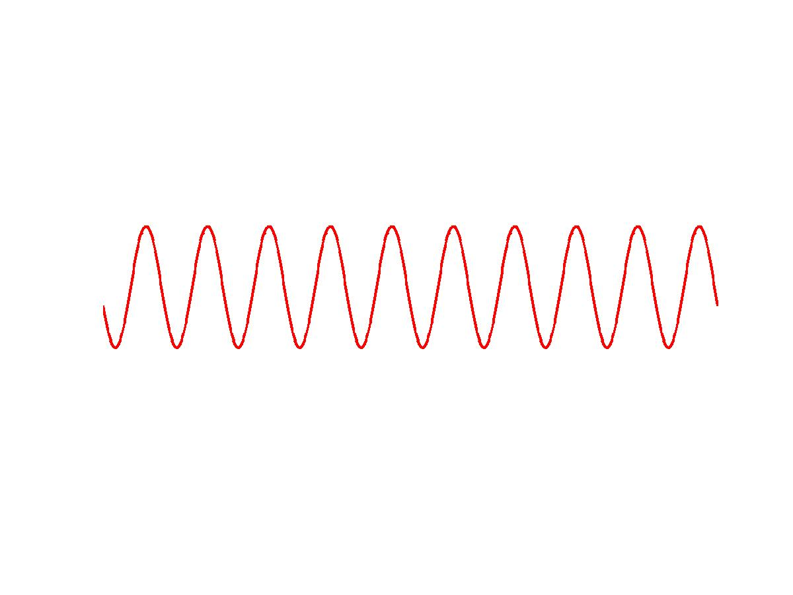
Spectral decomposition: the principle

Slide 12
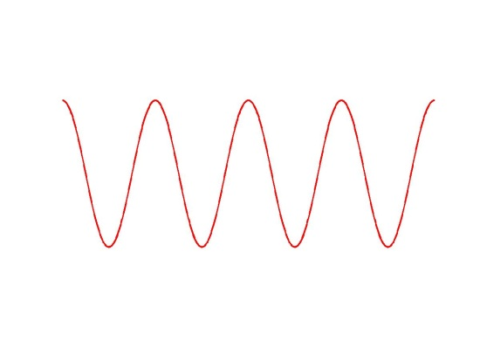
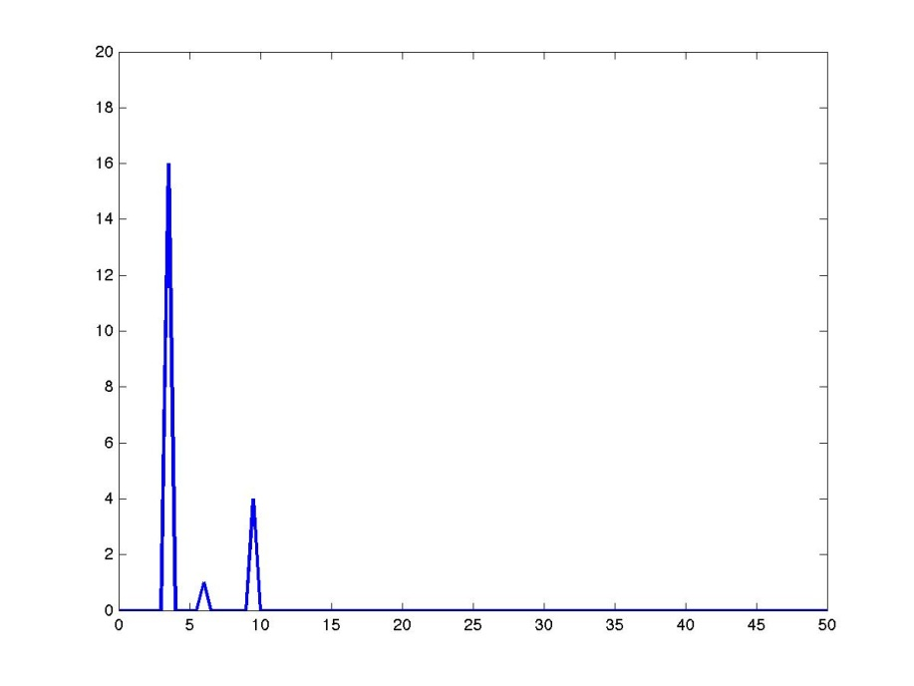
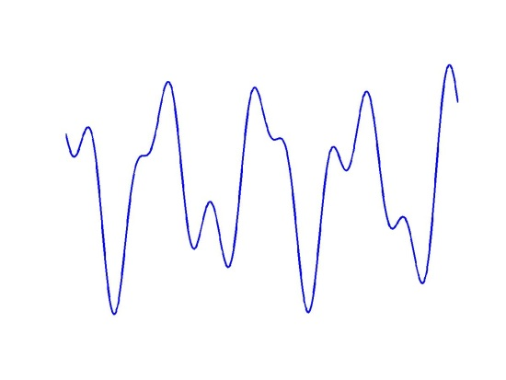
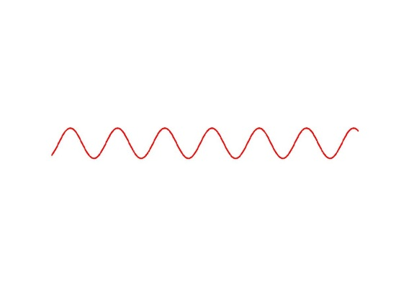
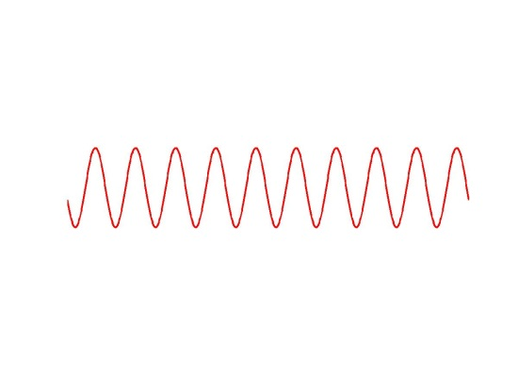
Spectral decomposition: the power spectrum
P(f) = |A(f)|²

Slide 13
Powerspectrum of real data
Notes:
13

Slide 14
Spectral analysis
cfg = [];
cfg.method = ‘…’;
.
.
.
freq = ft_freqanalysis(cfg, data);
‘mtmfft’;
Deconstructing a time domain signal into its constituent oscillatory components
Using simple oscillatory functions: cosines and sines
Each oscillatory component has an amplitude and phase
Different methods on the market
Several implementations in FieldTrip

Slide 15
Time-frequency relation
The frequency resolution (Δf) is determined by the length of the data segments (T)
Rayleigh frequency = 1/T = Δf = frequency resolution
Time window:
1 s
Frequencies:
(0) 1 2 3 4 5 6 .. Hz
Time window:
0.2 s
Frequencies:
(0) 5 10 15 20 .. Hz
Notes:
Fourier decomposition has discrete frequency steps: 1 cycle per time window, 2 cycles per time window, etc. That’s the reason for the Rayleigh frequency.
15

Slide 16
Time-frequency relation
The highest frequency that can be resolved depends on the sampling interval = Δt = 1 / f_{sample}
Nyquist frequency = 1/(2*Δt) = f_{sample} / 2
Sampling freq 1 kHz
Time window 1 s
Frequencies:
(0) 1 2 … 499 500 Hz
Sampling freq 400 Hz
Time window 0.25 s
Frequencies:
(0) 4 8... 196 200 Hz
Notes:
16

Slide 17
Time-frequency relation
Δt
Δt
Δt
Δt
Δt
Δt
Δt
Δt
Δt
Δt
1/T
1/T
1/T
1/T
1/T
0
1/(2*Δt)
T
cfg = [];
cfg.method = ‘mtmfft’;
cfg.foilim = […];
.
.
freq=ft_freqanalysis(cfg, data);
[flow fhigh];

Slide 18
Time-frequency relation
Δt
Δt
Δt
Δt
Δt
Δt
Δt
Δt
Δt
Δt
1/T
1/T
1/T
1/T
1/T
0
1/(2*Δt)
T
cfg = [];
cfg.method = ‘mtmfft’;
cfg.foi = […];
.
.
freq=ft_freqanalysis(cfg, data);
[f1 f2 f3];

Slide 19
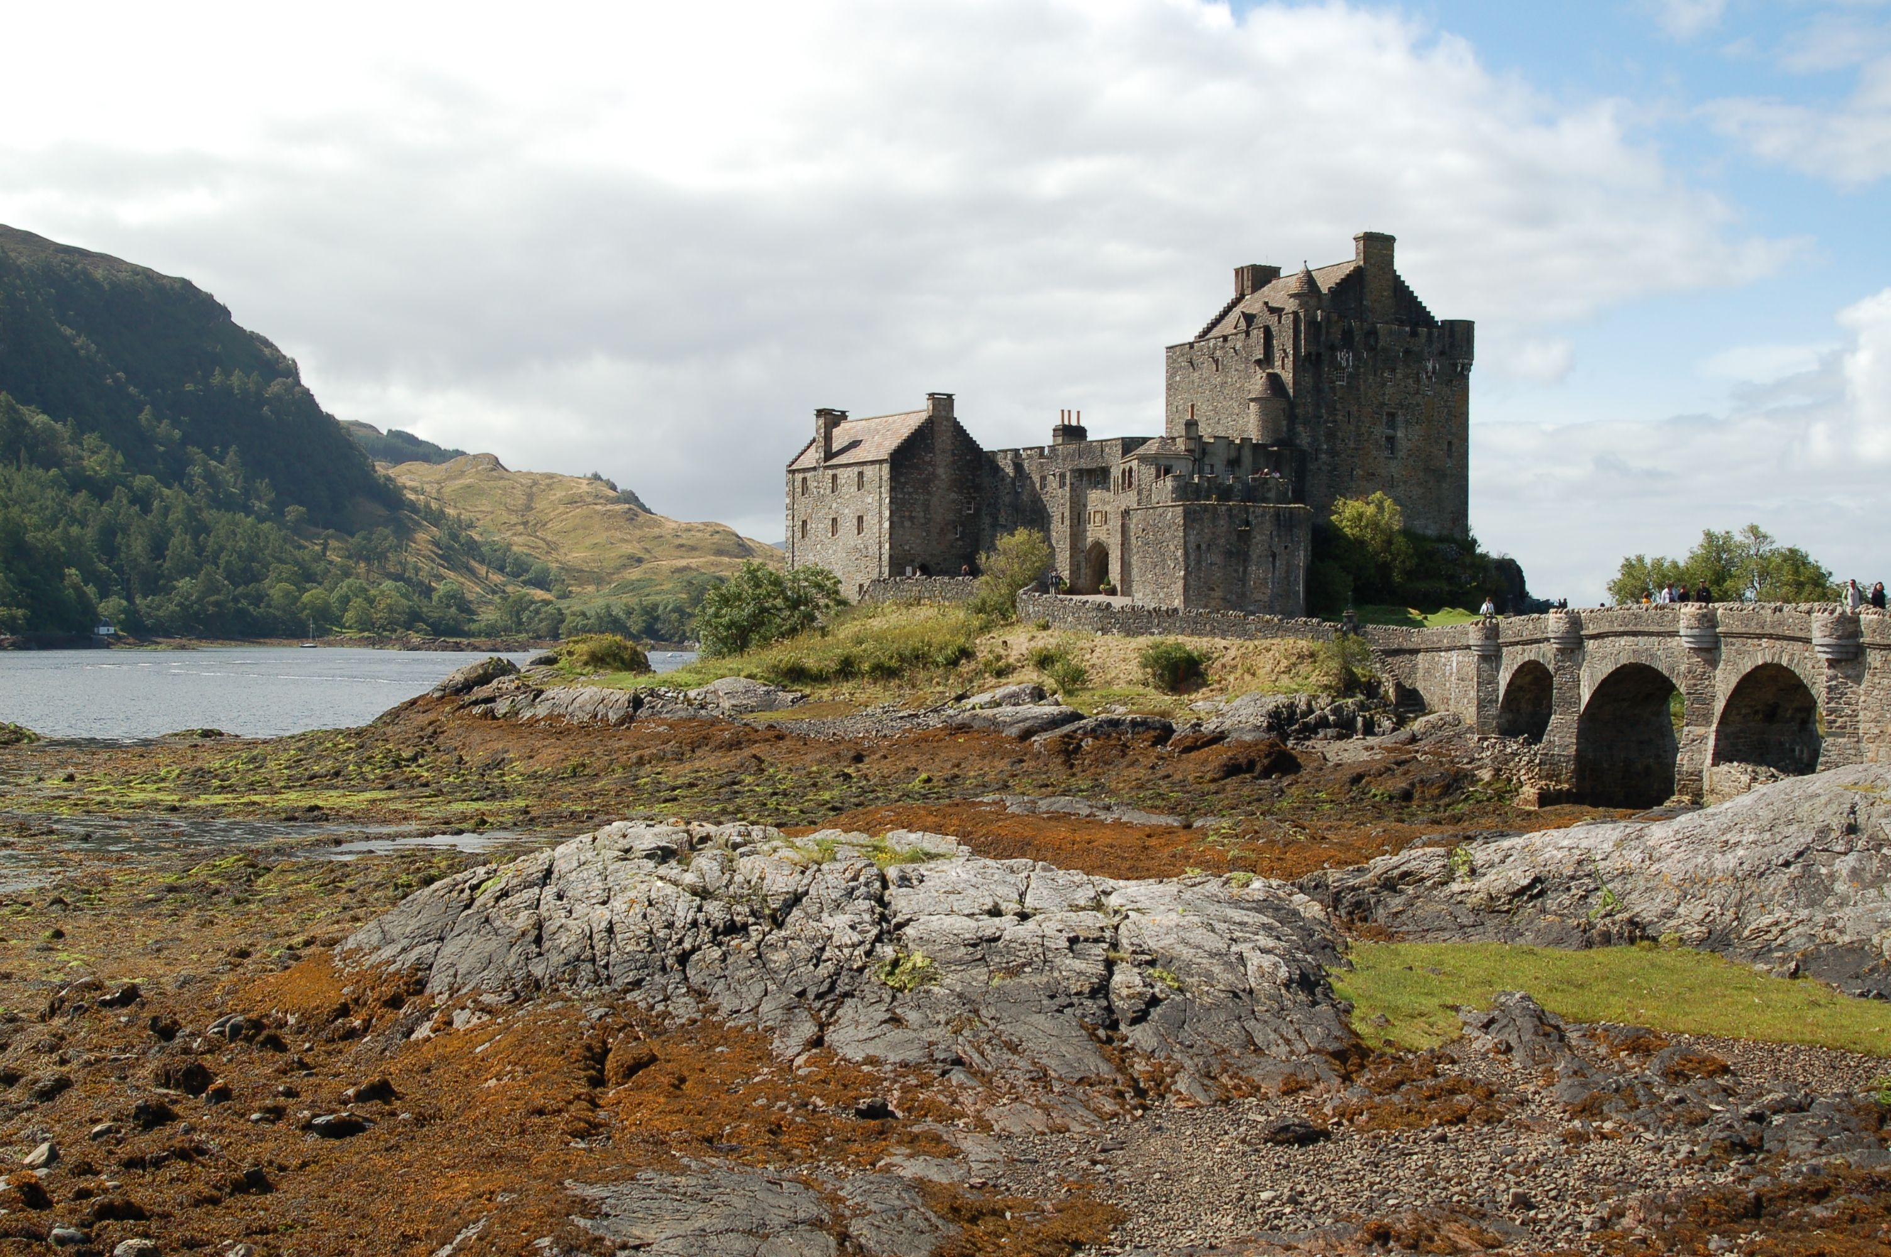
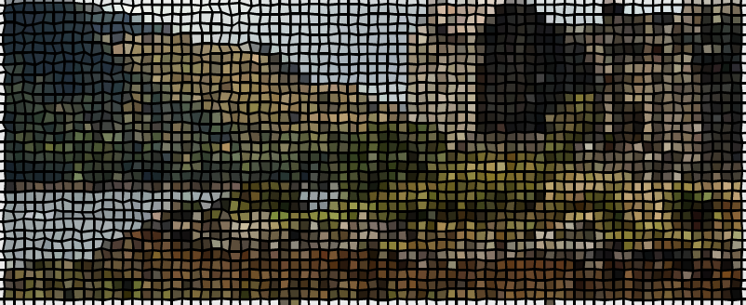
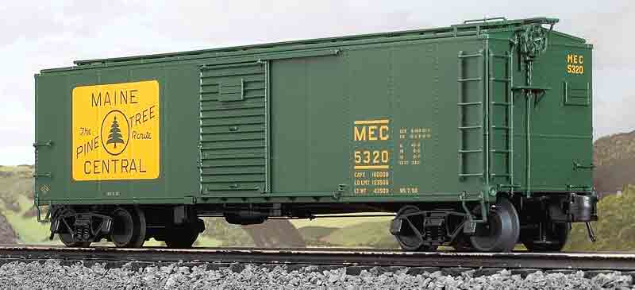
Goal and challenges
Estimate the true oscillations from the data
Limited time available for Fourier transform
You are looking at the activity through a time restricting window
This implicitly means that the data are ‘tapered’ with a boxcar
Data are discretely sampled

Slide 20
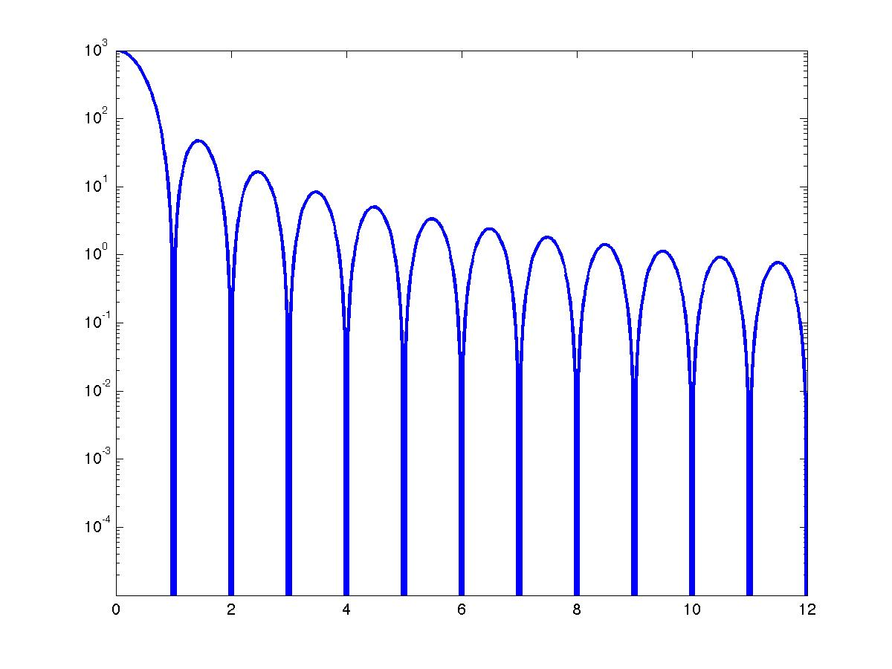
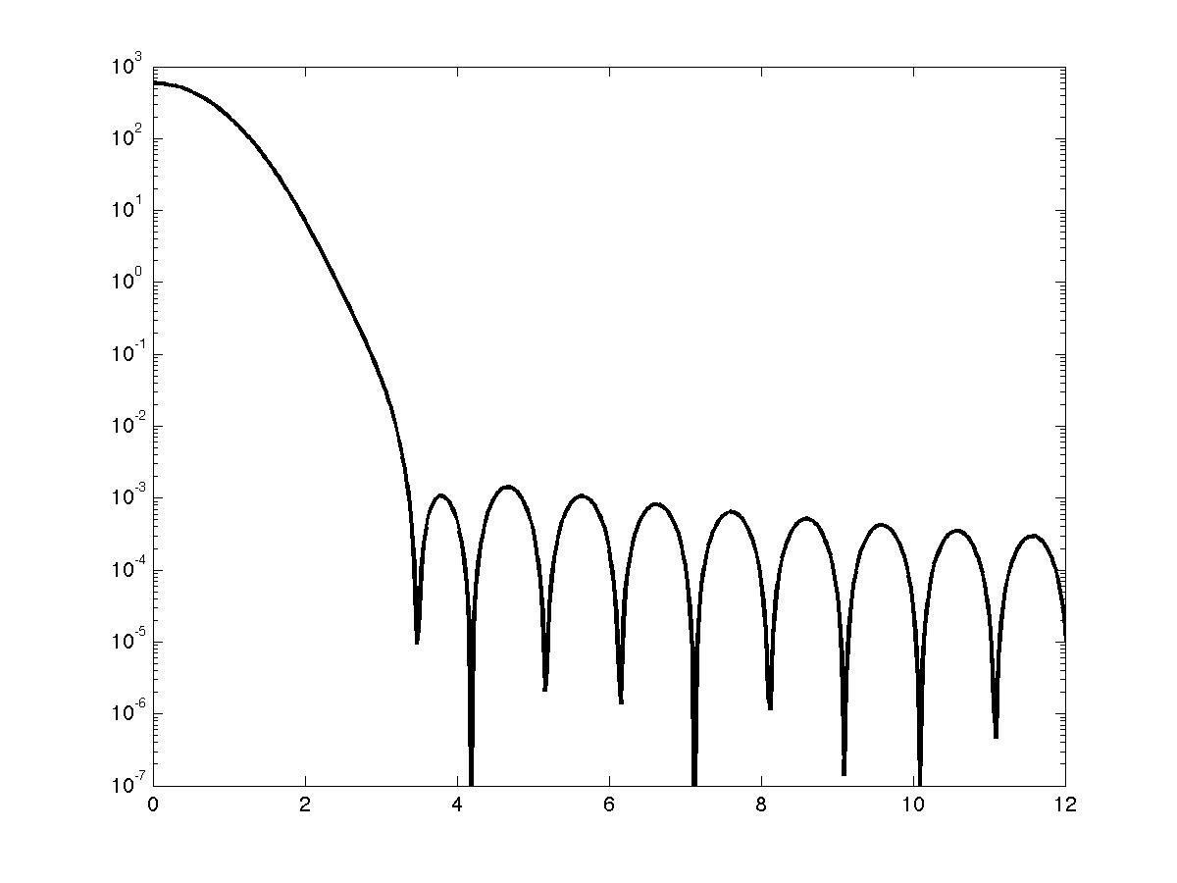
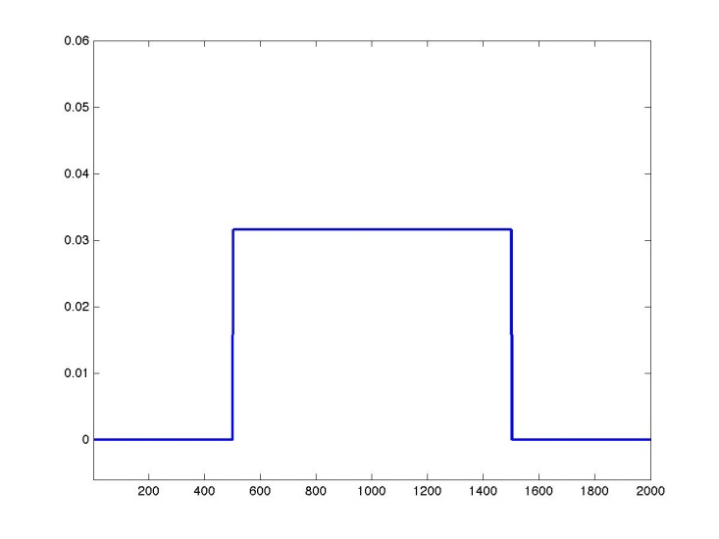
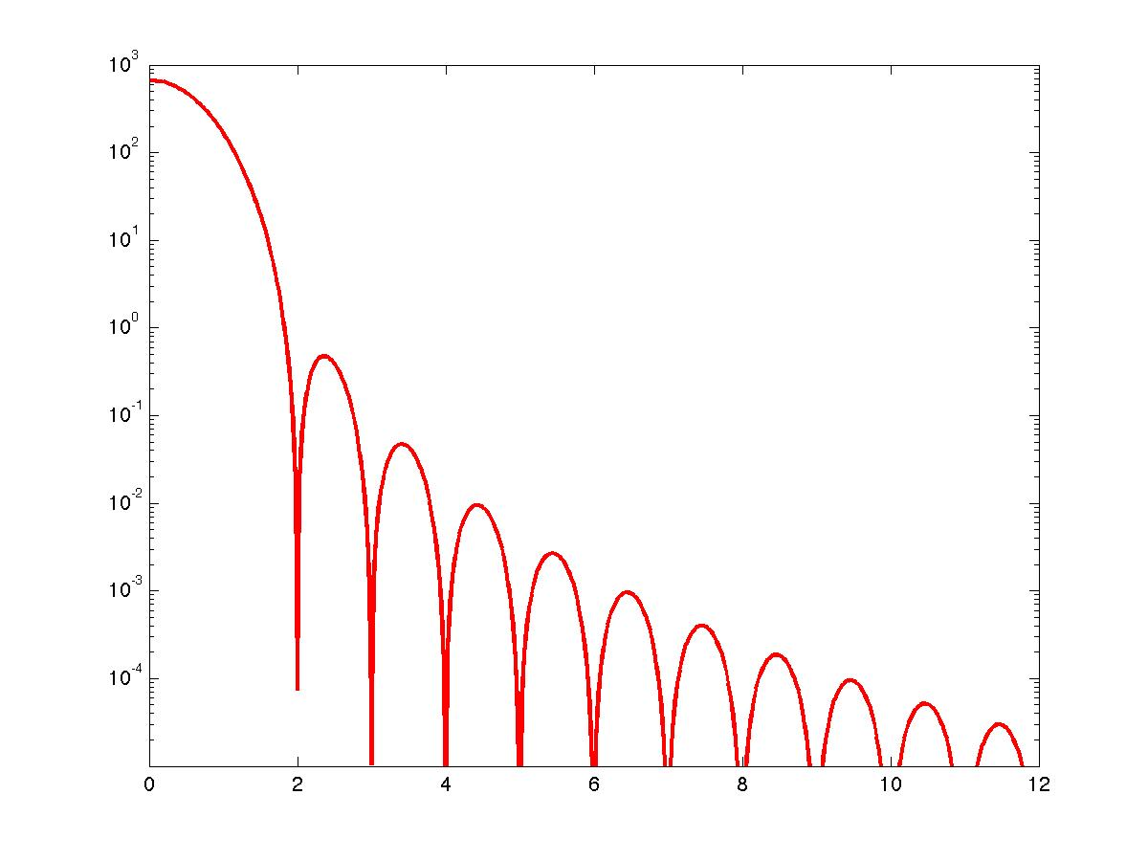
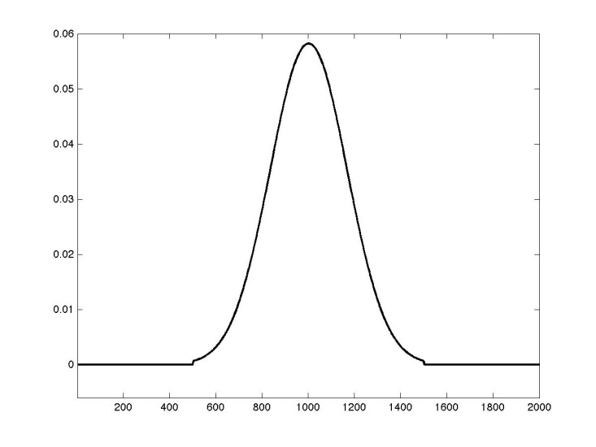
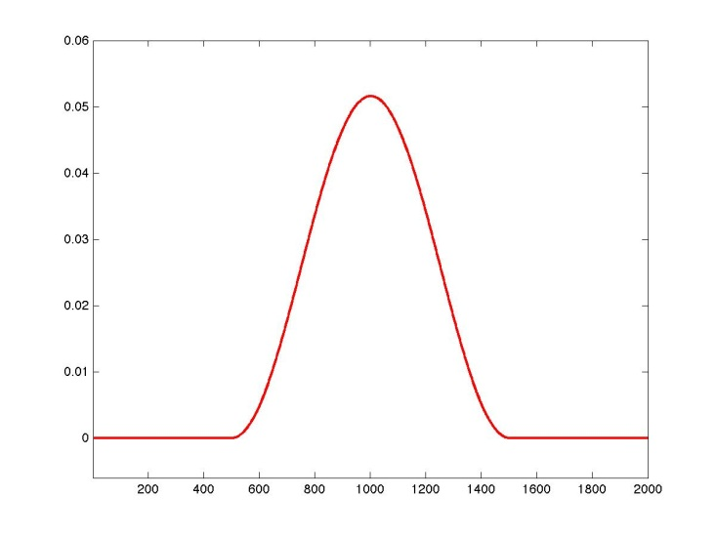
Spectral leakage and tapering
Through spectral leakage each frequency’s estimate may be polluted by true oscillations at other frequencies
Not tapering = applying a boxcar taper
Each type of taper has a specific leakage profile
main lobe
sidelobes

Slide 21
Multitapers
Make use of more than one taper and combine their properties
Used for smoothing in the frequency domain
Instead of “smoothing” one can also say “controlled leakage”

Slide 22
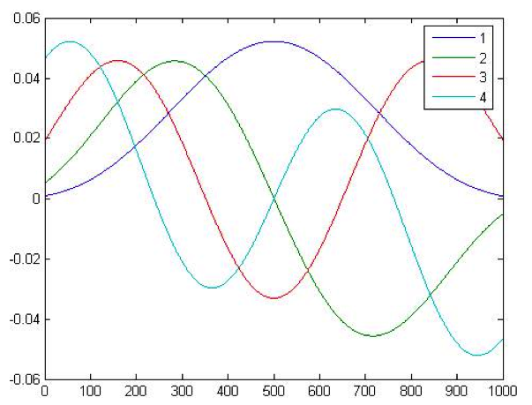
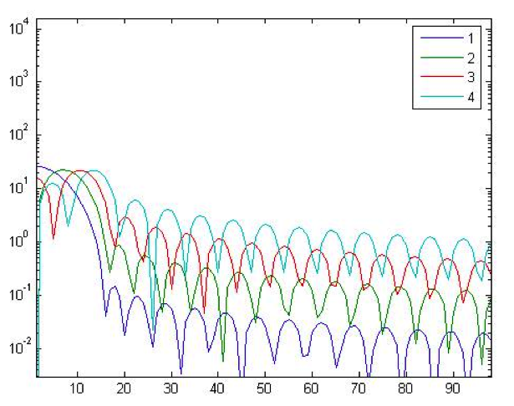
Multitapers

Slide 23
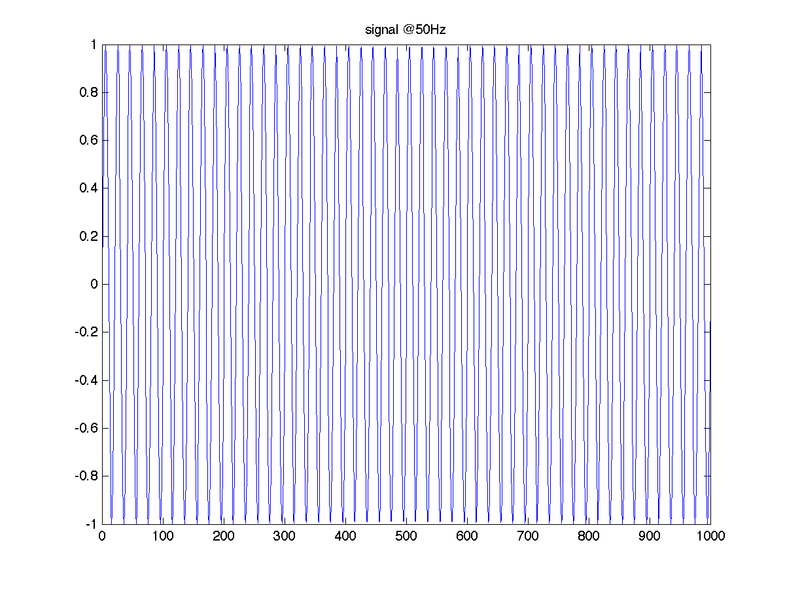
Multitapers demo

Slide 24
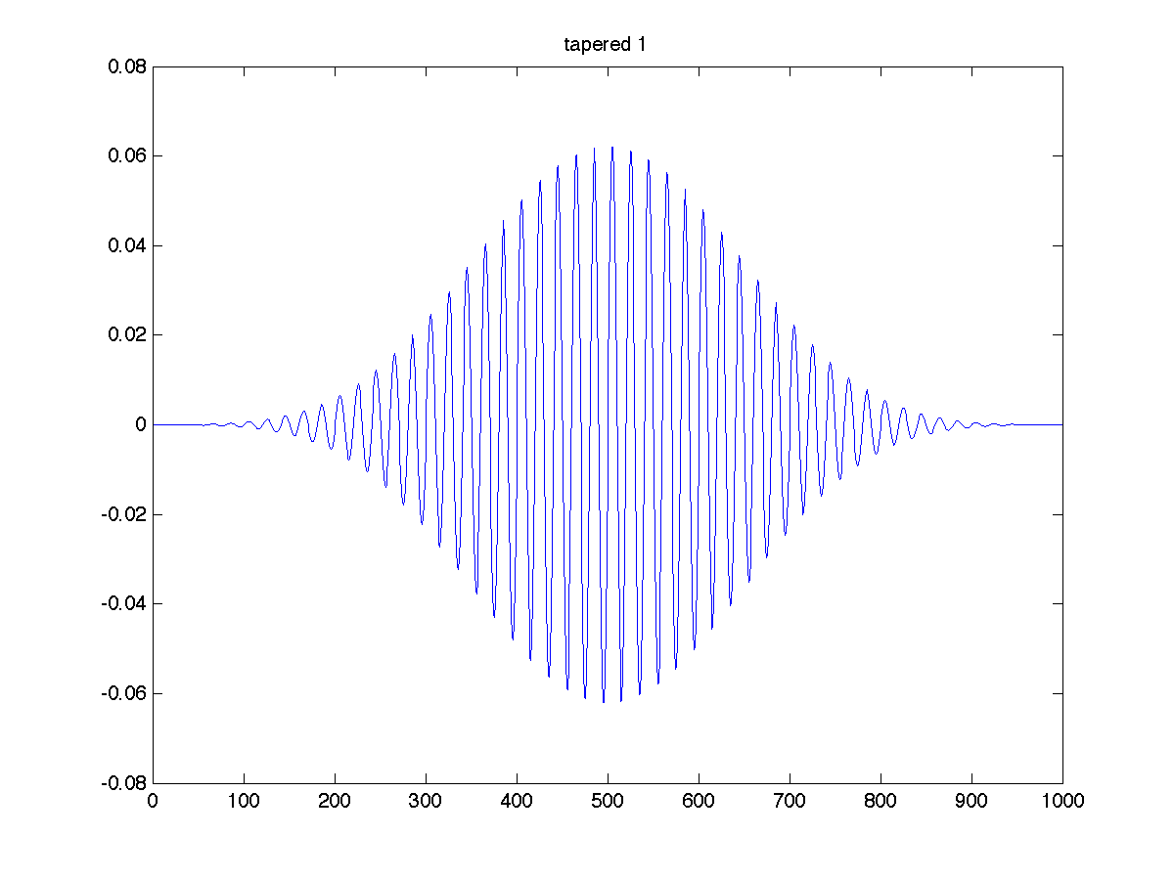
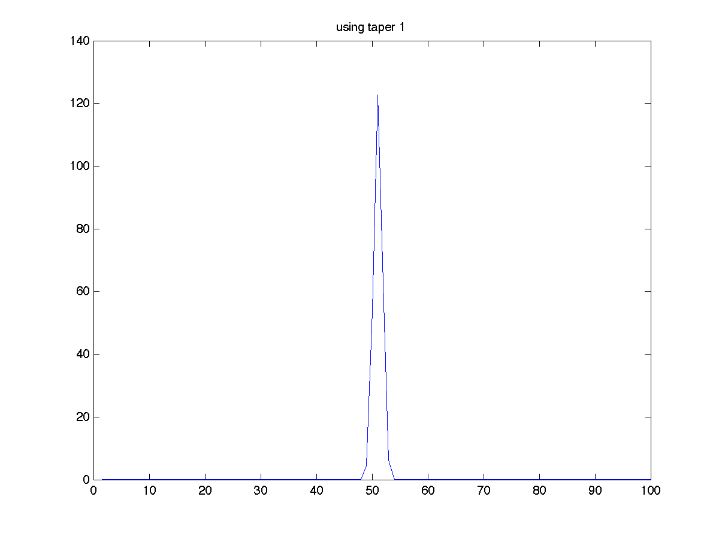
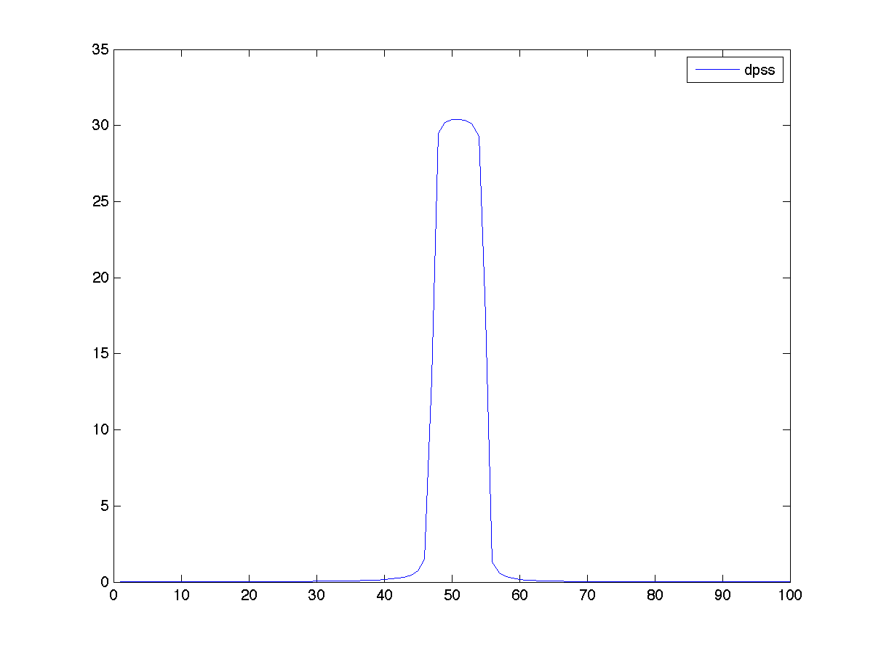
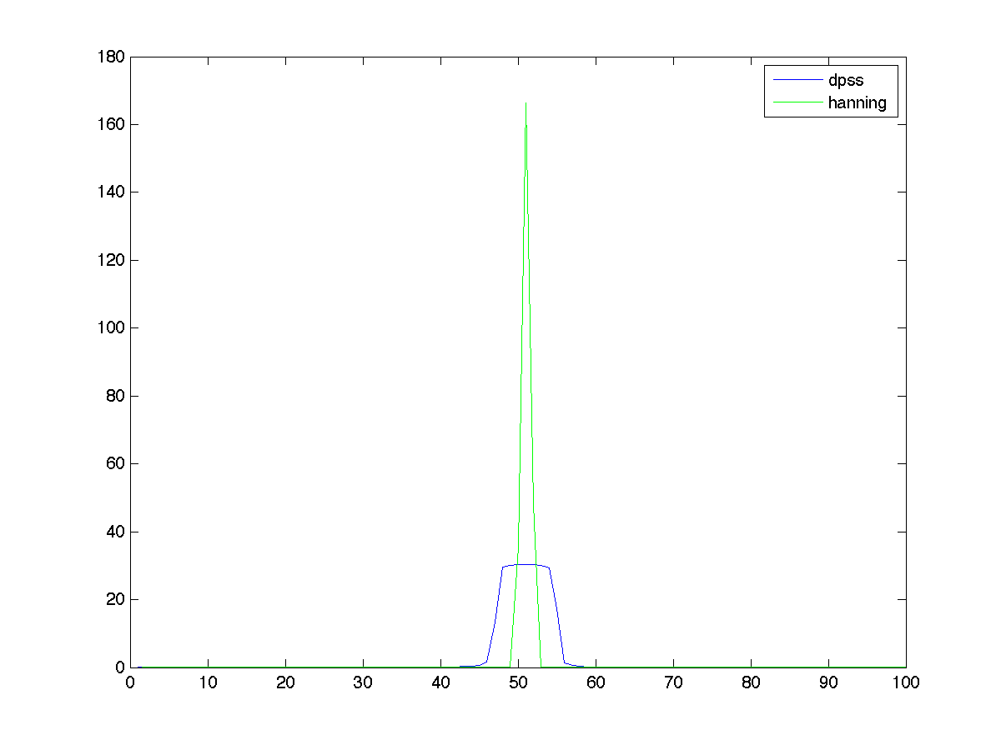
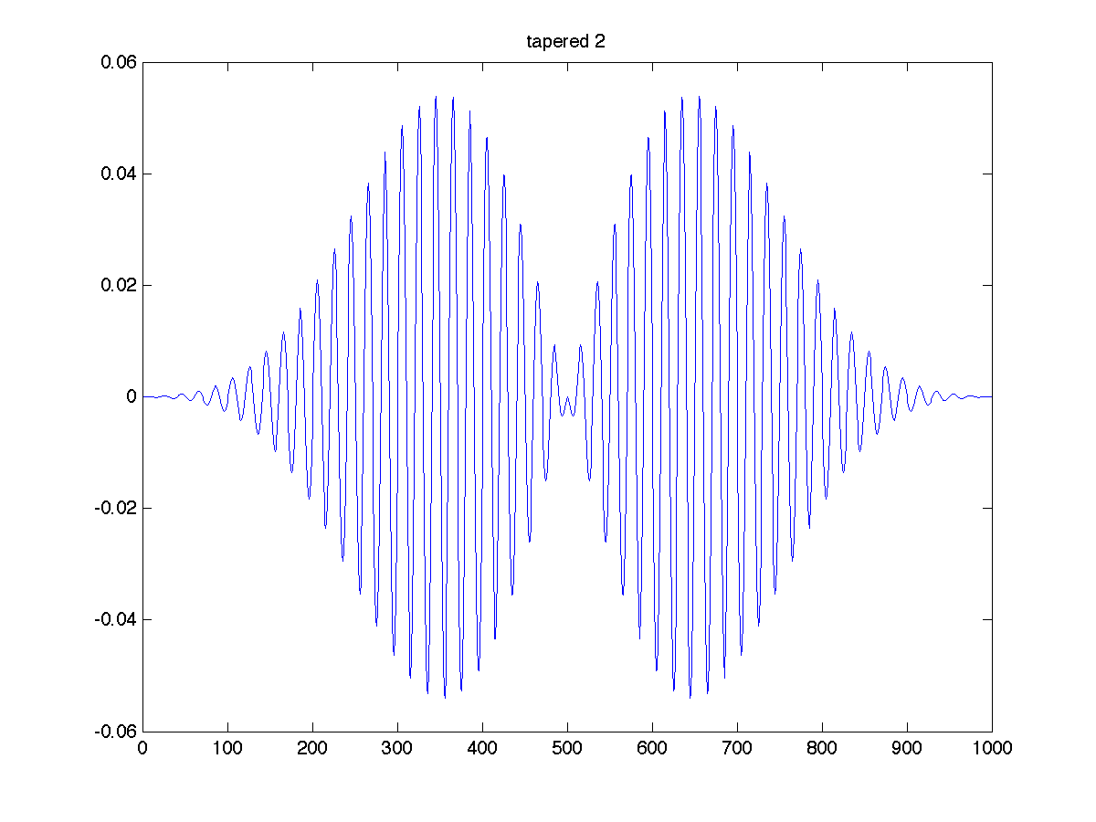
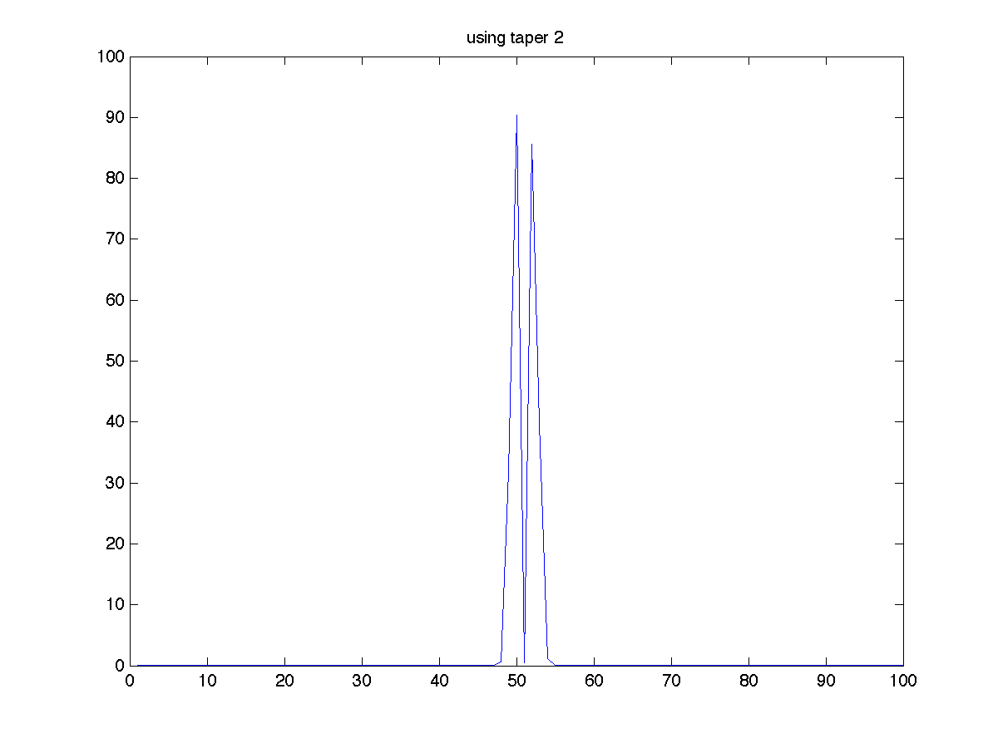
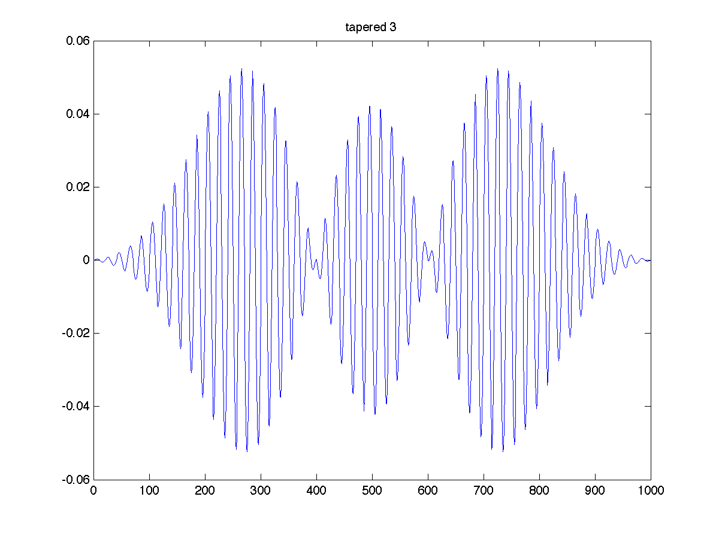
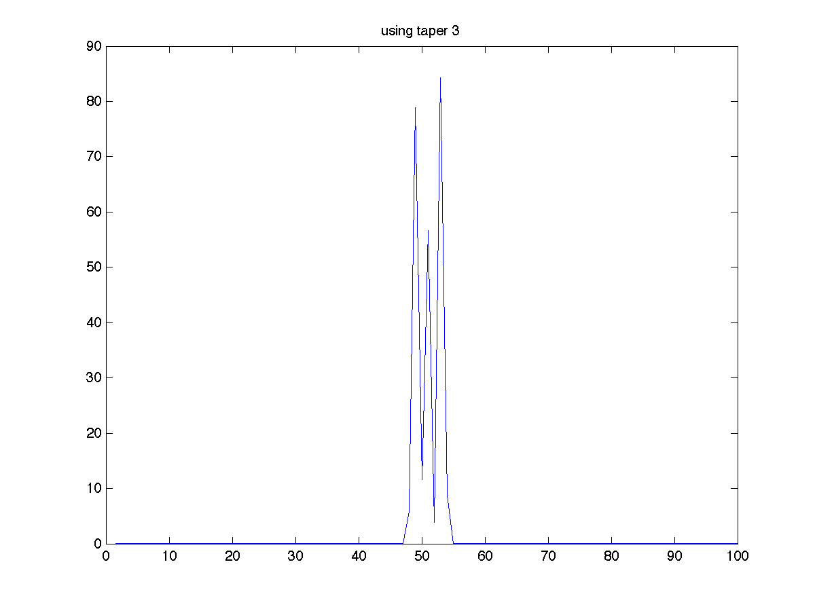
tapered signal
spectral estimate
averaged
spectral estimate

Slide 25
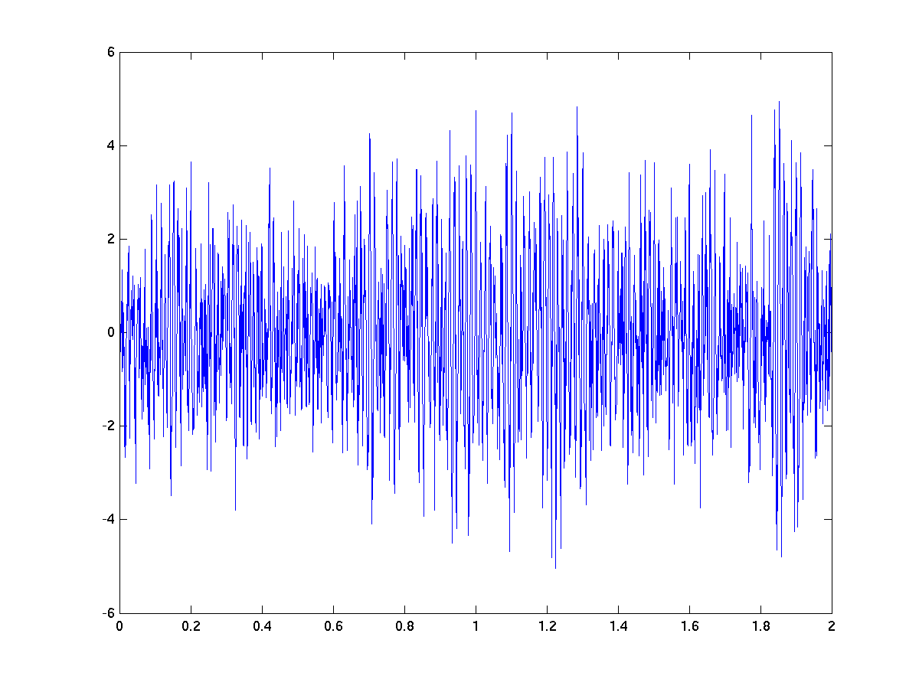
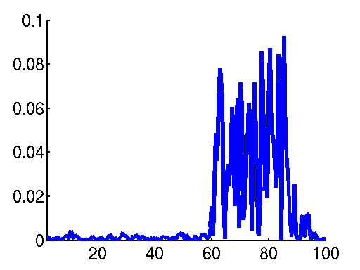
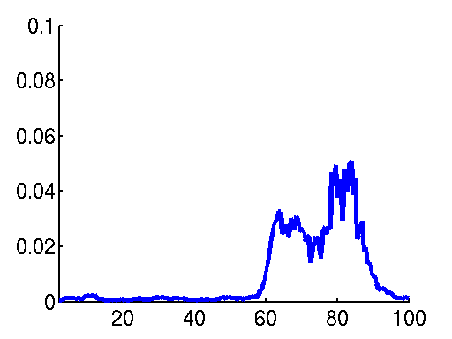
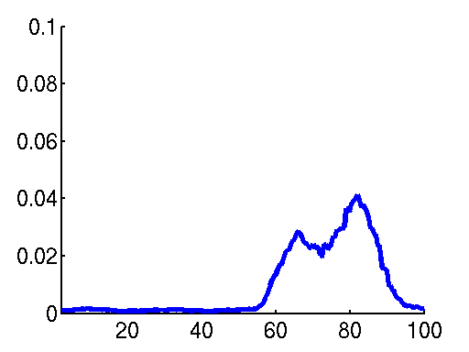
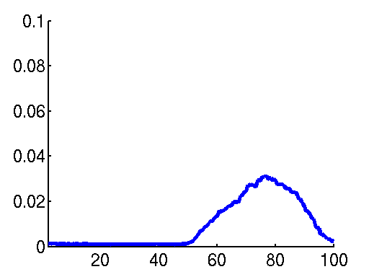
Multitapers
Hanning window
2 s
Broadband activity 60-90 Hz
2 Hz smoothing 7 tapers
5 Hz smoothing 19 tapers
10 Hz smoothing 39 tapers
Notes:
25

Slide 26
Multitapers
Multitapers are useful for reliable estimation of high frequency components
Low frequency components are better estimated using a single (Hanning) taper
%estimate low frequencies
cfg = [];
cfg.method = ‘mtmfft’;
cfg.foilim = [1 30];
cfg.taper = ‘hanning’;
.
.
.
freq = ft_freqanalysis(cfg, data);
%estimate high frequencies
cfg = [];
cfg.method = ‘mtmfft’;
cfg.foilim = [30 120];
cfg.taper = ‘dpss’;
cfg.tapsmofrq = 8;
.
.
freq = ft_freqanalysis(cfg, data);

Slide 27
Sub summary
Spectral analysis
Decompose signal into its constituent oscillatory components
Focused on ‘stationary’ power
Tapers
Boxcar, hanning, gaussian
Multitapers
Control spectral leakage/smoothing

Slide 28
Time-frequency analysis
Typically, brain signals are not ‘stationary’
Divide the measured signal in shorter time segments and apply Fourier analysis to each signal segment
Everything we saw so far with respect to frequency resolution applies here as well
cfg = [];
cfg.method = ‘…’;
.
.
.
freq = ft_freqanalysis(cfg, data);
‘mtmconvol’;

Slide 29
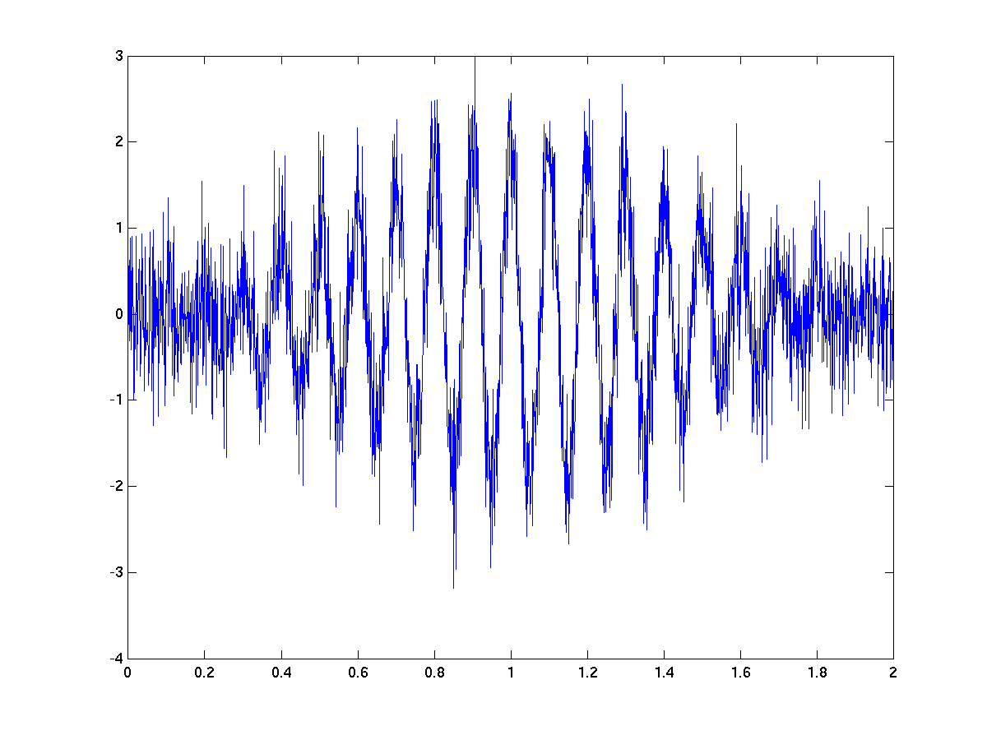
Time frequency analysis
Time (s)
Notes:
29

Slide 30
Time frequency analysis
Time (s)
DFT
Frequency (Hz)
high
power
Time (s)
0
Notes:
30

Slide 31
Time frequency analysis
Time (s)
DFT
Frequency (Hz)
high
power
Time (s)
0
Notes:
31

Slide 32
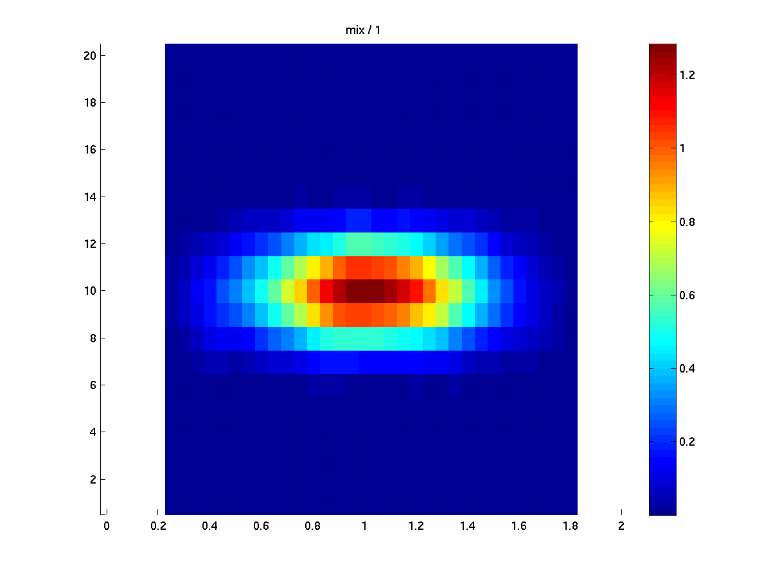
Time frequency analysis
Time (s)
DFT
Frequency (Hz)
high
power
Time (s)
0
Notes:
32

Slide 33
Time frequency analysis
Time (s)
DFT
Frequency (Hz)
high
power
Time (s)
0
Notes:
33

Slide 34
Time frequency analysis
Time (s)
DFT
Frequency (Hz)
high
power
Time (s)
0
Notes:
34

Slide 35
Time frequency analysis
Time (s)
DFT
Frequency (Hz)
high
power
Time (s)
0
Notes:
35

Slide 36
Time frequency analysis
Time (s)
DFT
Frequency (Hz)
high
power
Time (s)
0
Notes:
36

Slide 37
Time frequency analysis
Time (s)
DFT
Frequency (Hz)
high
power
Time (s)
0
Notes:
37

Slide 38
Time frequency analysis
Time (s)
DFT
Frequency (Hz)
high
power
Time (s)
0
Notes:
38

Slide 39
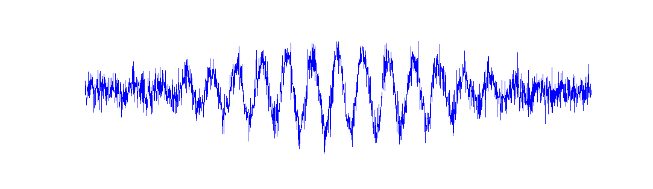

















Evoked versus induced activity
Freq (Hz)
Time (s)
Time (s)
Time (s)
Notes:
39

Slide 40











Noisy signal -> many trials needed
Freq (Hz)
Time (s)
Time (s)
Notes:
40

Slide 41
The time-frequency plane
DFT
Time (s)
cfg = [];
cfg.method = ‘mtmconvol’;
cfg.foi = [2 4 … 40];
cfg.toi = [0:0.050:1.0];
cfg.t_ftimwin = [0.5 0.5 … 0.5];
.
.
.
freq = ft_freqanalysis(cfg, data);
Frequency (Hz)
Time (s)

Slide 42

The time-frequency plane
Division is ‘up to you’
Depends on the phenomenon you want to investigate
Which frequency band?
Which time scale?

Slide 43







Time versus frequency resolution
short timewindow
long timewindow
Notes:
43

Slide 44
Temporal smoothing
cfg = [];
cfg.method = ‘mtmconvol’;
cfg.foi = [2 4 … 40];
cfg.toi = [0:0.050:1.0];
cfg.t_ftimwin = [0.5 0.5 … 0.5];
cfg.tapsmofrq = [2 2 … 2];
.
.
freq = ft_freqanalysis(cfg, data);
Typically we want some smoothing in both the time and frequency dimensions
Temporal smoothing → longer time windows
Longer time windows → higher frequency resolution (= less frequency smoothing)
Solution: multitapers

Slide 45
Sub summary
Time frequency analysis
Fourier analysis on shorter sliding time window
Evoked & Induced activity
Time frequency resolution trade off
Temporal smoothing

Slide 46
Wavelet analysis
Popular method to calculate time-frequency representations
Is based on convolution of signal with a family of ‘wavelets’ which capture different frequency components in the signal

Slide 47
Wavelet analysis
cfg = [];
cfg.method = ‘…’;
.
.
.
freq = ft_freqanalysis(cfg, data);
‘wltconvol’;

Slide 48





Wavelets
Sine wave
Taper
=
X
Cosine wave
=

Slide 49

Wavelet analysis
Wavelet width determines time-frequency resolution
Width function of frequency (often 5 cycles)
‘Long’ wavelet at low frequencies leads to relatively narrow frequency resolution but poor temporal resolution
‘Short’ wavelet at high frequencies leads to broad frequency resolution but more accurate temporal resolution

Slide 50
Wavelet analysis
Very similar to Fourier analysis, but
Tiles the time frequency plane in a particular way with few degrees of freedom
%time frequency analysis with
%multitapers
cfg = [];
cfg.method = ‘mtmconvol’;
cfg.toi = [0:0.05:1];
cfg.foi = [4 8 … 80];
cfg.t_ftimwin = [0.5 0.5 … 0.5];
cfg.tapsmofrq = [2 2 … 2];
.
.
freq = ft_freqanalysis(cfg, data);
%time frequency analysis with
%wavelets
cfg = [];
cfg.method = ‘wltconvol’;
cfg.toi = [0:0.05:1];
cfg.foi = [4 8 … 80];
cfg.width = 7;
.
.
.
freq = ft_freqanalysis(cfg, data);

Slide 51
Summary
Spectral analysis
Relation between time and frequency domains
Tapers
Time frequency analysis
Time vs frequency resolution
Wavelets
Hands-on: Time-frequency analysis of power
Hanning window
Multi-tapers
Wavelets

